Slide 1


Sifat Shahriar Khan
June 21st, 2024
Rocket Science Meets Data Science: Analyzing Falcon 9 Launches
This Photo by Unknown Author is licensed under CC BY-SA

Slide 2

Outline
Executive Summary
Introduction
Methodology
Results
Conclusion
Appendix

Slide 3
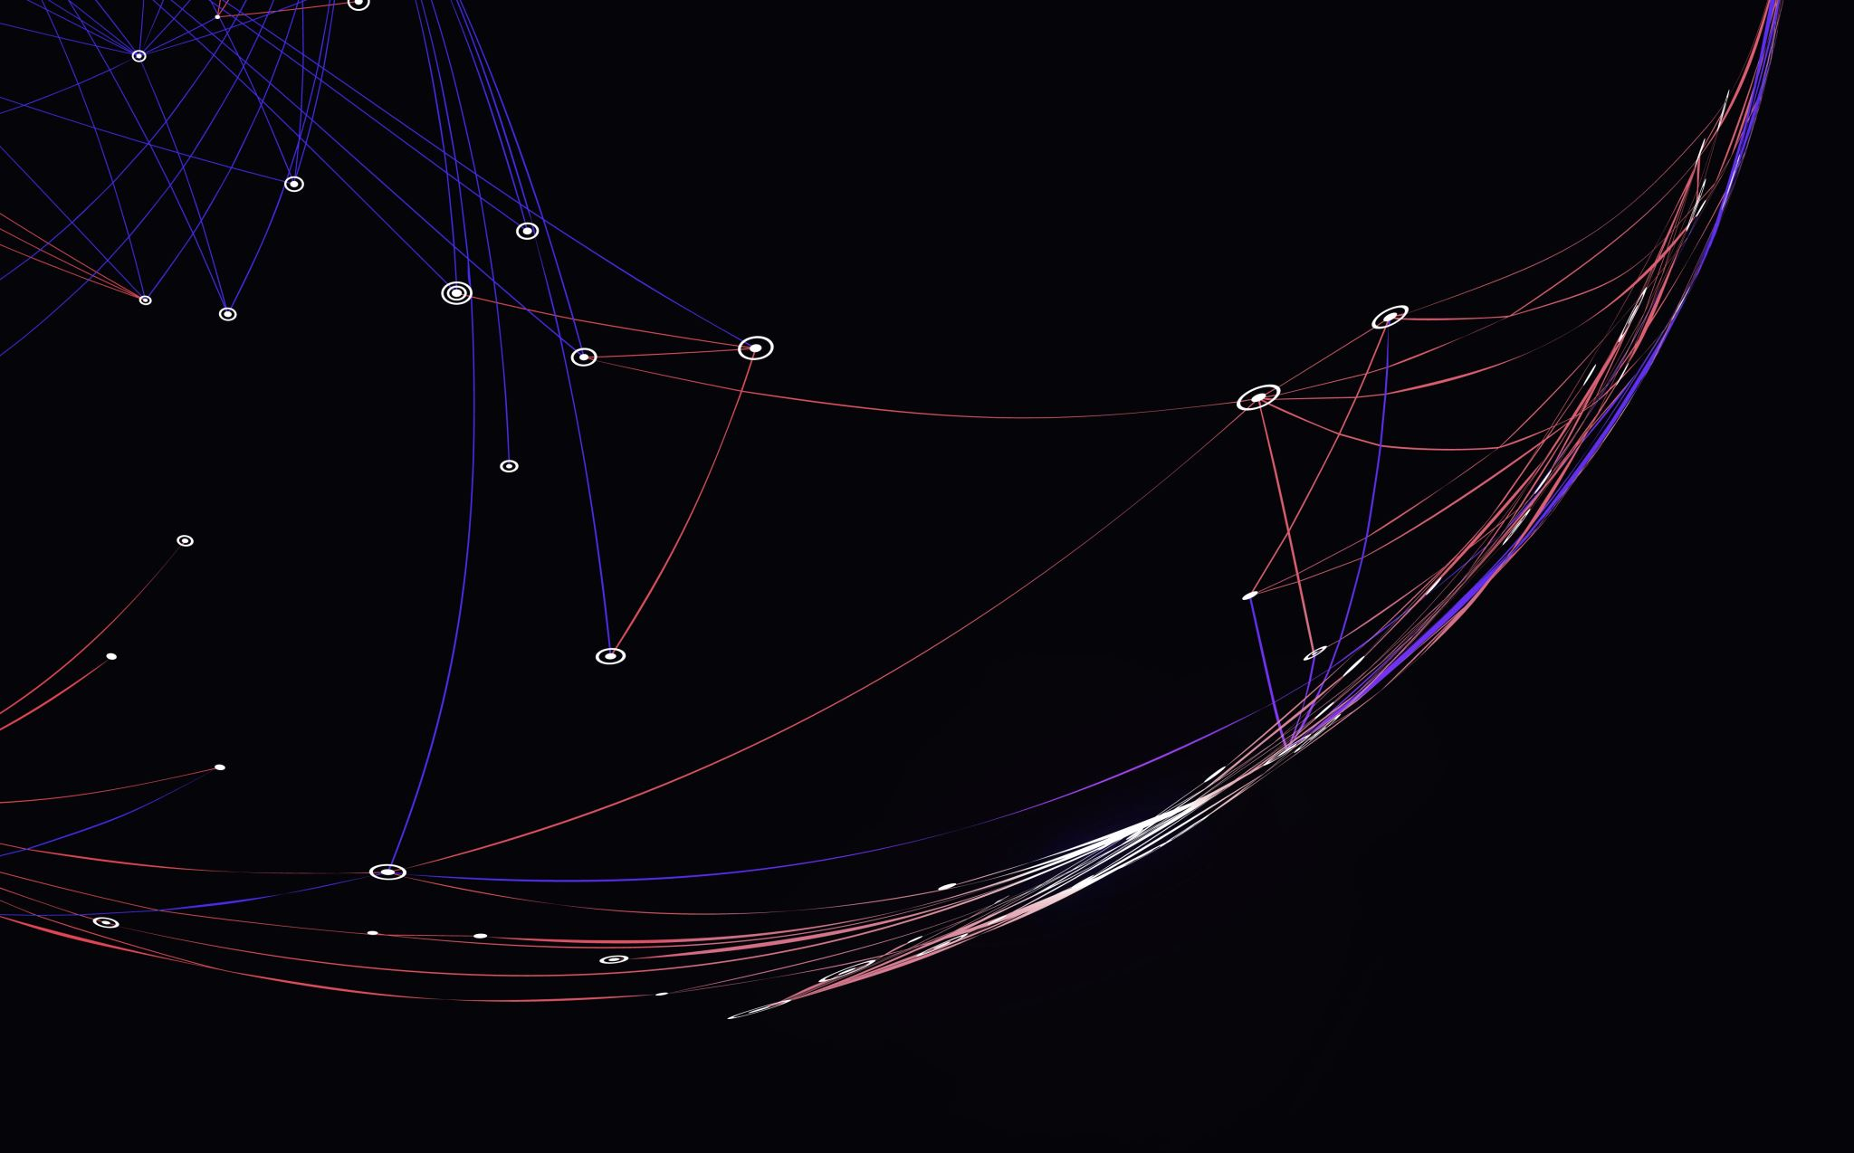
Executive Summary
In this project, we undertook a comprehensive analysis of SpaceX Falcon 9 launches using a variety of data science methodologies. Our approach included:
Data Collection: Utilizing the SpaceX API to retrieve detailed launch data.
Data Wrangling: Cleaning and preprocessing the collected data to ensure accuracy and consistency.
Exploratory Data Analysis (EDA) with Data Visualization: Analyzing the data to uncover insights and trends, visualized using tools like Matplotlib and Seaborn.
Exploratory Data Analysis with SQL: Performing complex queries to extract specific insights and aggregate information from the dataset.
Building an Interactive Map with Folium: Visualizing the geographical distribution of launch sites.
Building a Dashboard with Plotly Dash: Creating an interactive dashboard for dynamic data exploration and visualization.
Predictive Analysis (Classification): Applying machine learning techniques to predict the classification of the next landing, using Grid Search to optimize the model.

Slide 4
Introduction
Project Background and Context
SpaceX revolutionizes the commercial space industry by making space travel more affordable. A Falcon 9 rocket launch costs 62 million dollars, significantly less than other providers charging over 165 million dollars. This cost reduction is due to SpaceX's ability to reuse the first stage of their rockets. Predicting the success of these landings can help estimate launch costs. Using public data and machine learning, this project aims to predict the reusability of Falcon 9's first stage.
Questions to Be Answered
How do factors like payload mass, launch site, number of flights, and orbits affect first stage landing success?
Has the success rate of landings improved over the years?
Can we predict the success of a first stage landing for new launches based on historical data?
What is the best binary classification algorithm for this prediction?
What factors ensure a successful launch, and how can this information optimize future launches?

Slide 5
Methodology
Section 1

Slide 6

Methodology
Executive Summary:
Data Collection:
Utilized the SpaceX REST API
Web scraping from Wikipedia
Data Wrangling:
Filtered the data
Handled missing values
Applied One Hot Encoding for binary classification preparation
Exploratory Data Analysis (EDA):
Conducted EDA using visualizations and SQL queries
Interactive Visual Analytics:
Created interactive visualizations using Folium and Plotly Dash
Predictive Analysis:
Built, tuned, and evaluated classification models for optimal results
Employed GridSearchCV to identify the best-fitting model

Slide 7
Data Collection
REST API
Web Scraping
SpaceX REST API
SpaceX Wikipedia Entry
The data collection process combined API requests from the SpaceX REST API and web scraping from SpaceX’s Wikipedia page. Both methods were necessary to obtain comprehensive launch information for detailed analysis.
JSON
HTML
Pandas DataFrame
Pandas DataFrame

Slide 8

Data Collection – SpaceX API
API Endpoint: https://api.spacexdata.com/v4/launches/past
Tasks:
Requested rocket launch data from the SpaceX API.
Decoded the response content using .json() and converted it to a dataframe with pd.json_normalize().
Applied custom functions to extract necessary launch information.
Constructed a dictionary from the obtained data.
Created a dataframe from the dictionary.
Filtered the dataframe to include only Falcon 9 launches.
Replaced missing values in the Payload Mass column with the column's mean value.
Exported the processed data to a CSV file.

Slide 9
Data Collection – Web Scraping
Wikipedia Falcon Page: https://en.wikipedia.org/wiki/List_of_Falcon_9_and_Falcon_Heavy_launches
Tasks:
Requested Falcon 9 launch data from Wikipedia.
Created a BeautifulSoup object from the HTML response.
Extracted column names from the HTML table header.
Parsed HTML tables to collect the data.
Constructed a dictionary from the obtained data.
Created a dataframe from the dictionary.
Exported the data to a CSV file.

Slide 10
Data Wrangling
Original Outcome
Landing Class
Handling Booster Landing Outcomes:
Converted landing outcomes into training labels:
1 for successful landings and 0 for unsuccessful landings.
Data Wrangling:
Determined training labels.
Calculated the number of launches at each site.
Counted occurrences of each orbit type.
Analyzed mission outcomes per orbit type.
Created a landing outcome label from the Outcome column.
Export:
Exported the processed data to a CSV file.
True ASDS
None None
True RTLS
False ASDS
True Ocean
False Ocean
None ASDS
False RTLS
1
0
1
0
1
0
0
0

Slide 11
EDA with data visualization
Charts Plotted
Scatter Plots: Identify relationships between variables for potential use in machine learning models.
Flight Number vs. Payload Mass
Flight Number vs. Launch Site
Payload Mass vs. Launch Site
Flight Number vs. Orbit Type
Payload Mass vs. Orbit Type
Bar Charts: Compare success rates across different orbit types.
Success rate of each orbit type
Line Charts: Track trends in launch success rates over time.
Yearly average launch success trend

Slide 12

EDA with SQL
Queries Performed:
Display unique launch site names.
Display five records where launch sites start with 'CCA'.
Display total payload mass carried by NASA (CRS) boosters.
Display average payload mass for booster version F9 v1.1.
List the date of the first successful ground pad landing.
List boosters with successful drone ship landings and payload mass between 4000 and 6000.
List the total number of successful and failed mission outcomes.
List booster versions carrying the maximum payload mass.
List failed drone ship landings in 2015, including booster versions and launch site names.
Rank landing outcomes by count between 2010-06-04 and 2017-03-20 in descending order.

Slide 13
Interactive Map with Folium
Markers of All Launch Sites:
Added a marker with a circle, popup label, and text label for NASA Johnson Space Center as the start location.
Added markers with circles, popup labels, and text labels for all launch sites to show their geographical locations and proximity to the equator and coasts.
Coloured Markers for Launch Outcomes:
Added green markers for successful launches and red markers for failed launches using Marker Cluster to highlight launch site success rates.
Distances to Proximities:
Added coloured lines to show distances from Launch Site KSC LC-39A to nearby features like railways, highways, coastlines, and the closest city.

Slide 14
Dashboard with Plotly Dash
Launch Sites Dropdown:
Added a dropdown to select a launch site.
Success Launches Pie Chart:
Added a pie chart to display total successful launches for all sites or success vs. failure counts for a selected site.
Payload Mass Range Slider:
Added a slider to select the payload mass range.
Payload vs. Success Rate Scatter Chart:
Added a scatter chart to show the correlation between payload mass and launch success for different booster versions.

Slide 15
Predictive analysis
Binary Classification
Data Preparation
Create a NumPy array from the "Class" column.
Standardize the data using StandardScaler.
Split the data into training and testing sets with train_test_split.
Model Development
Create a GridSearchCV object with cv = 10 to find the best parameters.
Apply GridSearchCV on LogReg, SVM, Decision Tree, and KNN models.
Model Evaluation
Calculate test data accuracy using the .score() method for all models.
Examine confusion matrices for all models.
Identify the best-performing method using Jaccard_score and F1_score metrics.

Slide 16
RESULTS
EDA results
Interactive analytics demo
Predictive analytics results

Slide 17
Exploratory Data Analysis
Section 2

Slide 18
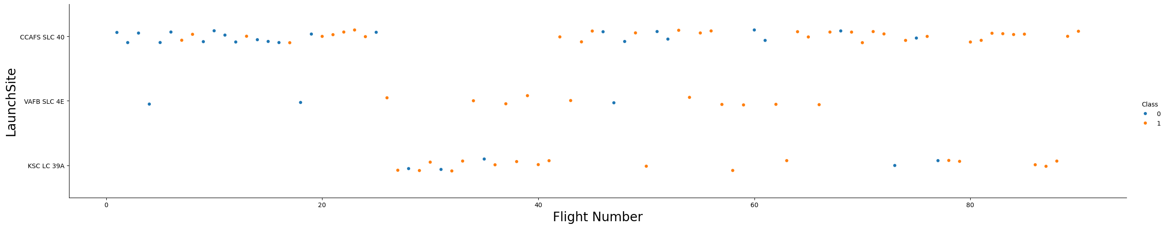
Flight Number vs. Launch Site
Early flights failed, while recent flights succeeded.
CCAFS SLC 40 hosts about half of all launches.
VAFB SLC 4E and KSC LC 39A have higher success rates.
Success rates improve with each new launch.

Slide 19
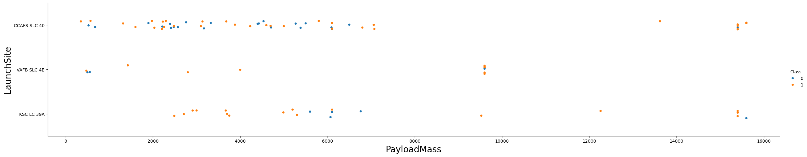
Payload vs. Launch Site
Higher payload mass generally leads to higher success rates.
Most launches with payloads over 7000 kg were successful.
KSC LC 39A has a 100% success rate for payloads under 5500 kg.

Slide 20
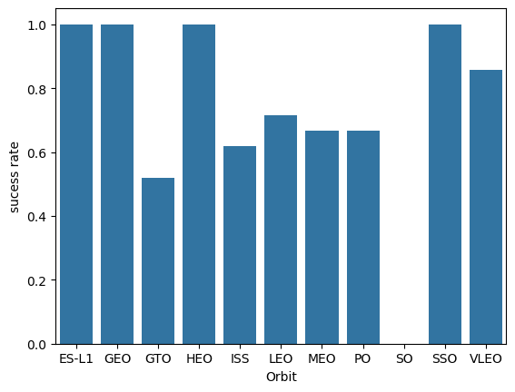
Success Rate vs. Orbit Type
100% Success Rate: ES-L1, GEO, HEO, SSO
0% Success Rate: SO
50% to 85% Success Rate: GTO, ISS, LEO, MEO, PO

Slide 21
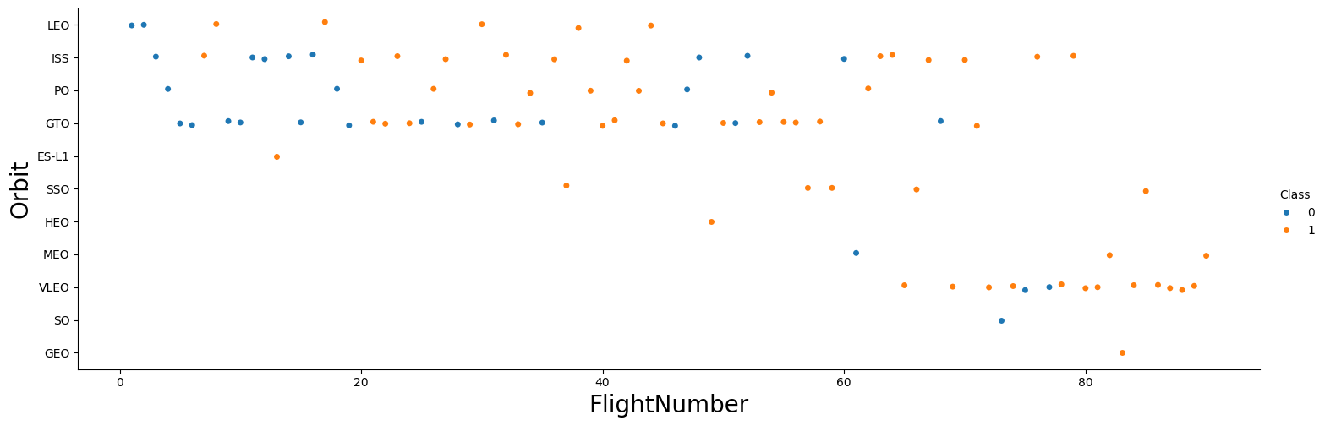
Flight Number vs. Orbit Type
Success in ES-L1, GEO, HEO, SSO Orbits: All launches are successful.
LEO Orbit: Success rate increases with flight number.
GTO Orbit: No clear relationship between flight number and success.

Slide 22
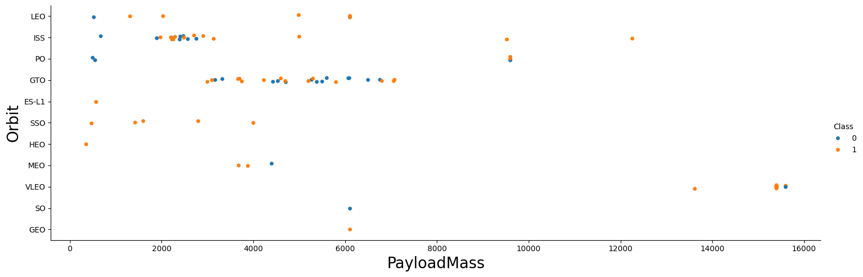
Payload vs. Orbit Type
Heavy Payloads: Increase success rate for Polar, LEO, and ISS orbits.
GTO Orbit: Mixed results with both successful and unsuccessful landings.

Slide 23
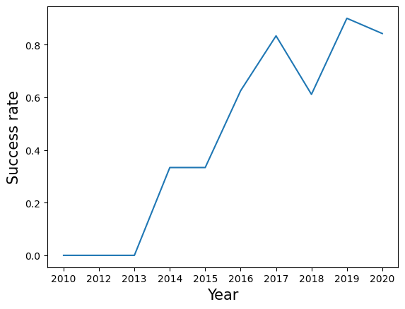
Launch Success Yearly Trend
Trend: Success rate has been increasing steadily from 2013 to 2020.

Slide 24
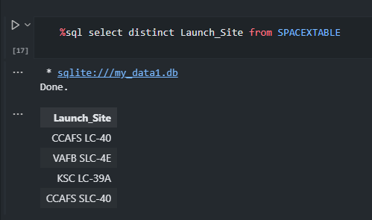
All Launch Site Names
Four Launch Sites:
CCAFS LC-40
VAFB SLC-4E
KSC LC-39A
CCAFS SLC-40
1 in western coast
VAFB SLC-4E
3 in eastern coast
KSC LC-39A
CCAFS SLC-40
CCAFS LC-40
Notes:
Find the names of the unique launch sites
Present your query result with a short explanation here

Slide 25
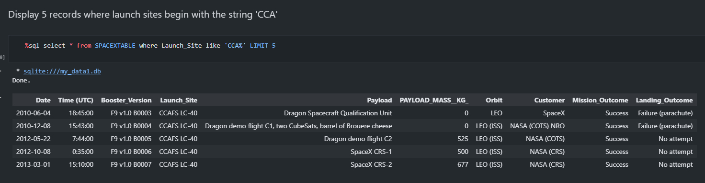
Launch Site Names Begin with 'CCA'
Displaying 5 records where launch sites begin with the string ‘CCA’
Notes:
Find 5 records where launch sites begin with `CCA`
Present your query result with a short explanation here

Slide 26
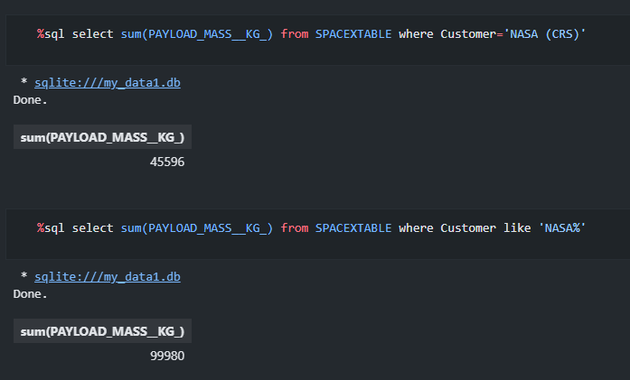
Total Payload Mass carried by Boosters launched by NASA
The total payload carried by boosters from NASA is 99980
the total payload mass carried by boosters launched by NASA (CRS).is 45596

Slide 27
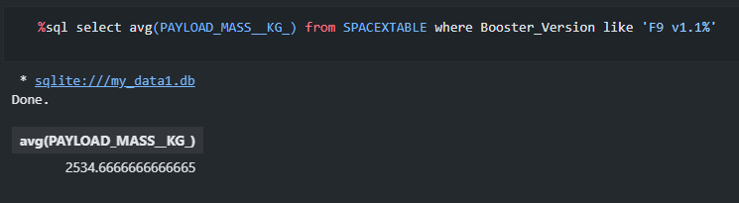
Average Payload Mass Carried by F9 v1.1
The average payload mass carried by booster version F9 v1.1 is 2534.67

Slide 28
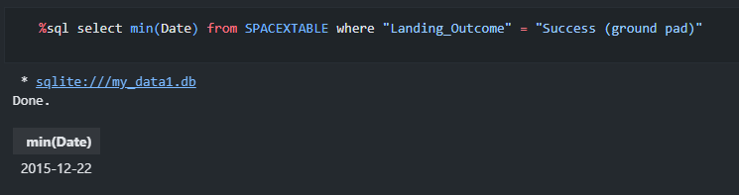
First Successful Ground Landing Date
The first successful landing outcome on ground pad is 01-05-2017

Slide 29
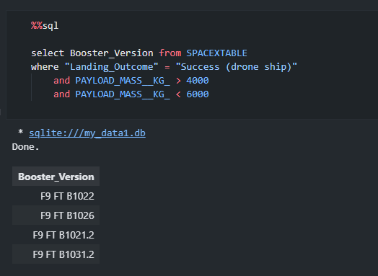
Successful Drone Ship Landing with Payload between 4000 and 6000
With payload mass greater than 4000 but less than 6000 the following booster made successfully landings on drone ship
F9 FT B1022
F9 FT B1026
F9 FT B1021.2
F9 FT B1031.2

Slide 30
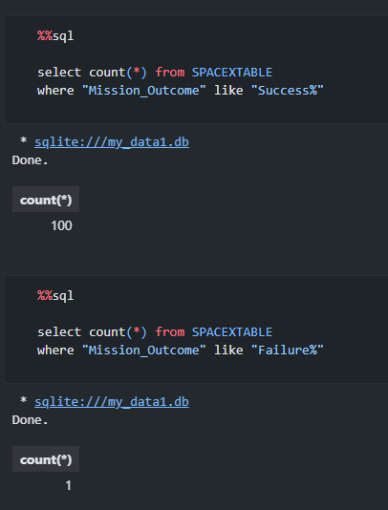
Total Number of Successful and Failure Mission Outcomes
Successful Mission Outcomes: 100
Failed Mission Outcomes: 1

Slide 31
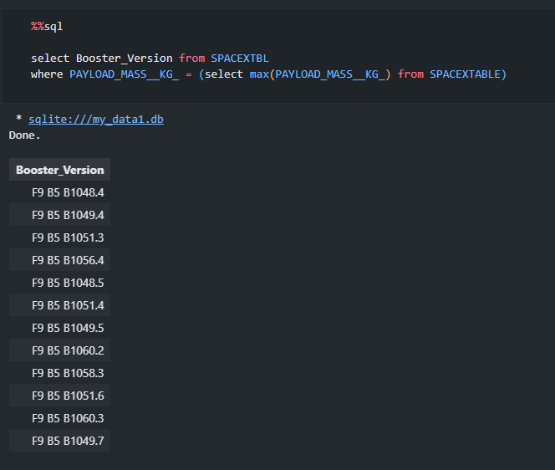
Boosters Carried Maximum Payload
Boosters which have carried the maximum payload mass:
F9 B5 B1048.4
F9 B5 B1049.4
F9 B5 B1051.3
F9 B5 B1056.4
F9 B5 B1048.5
F9 B5 B1051.4
F9 B5 B1049.5
F9 B5 B1060.2
F9 B5 B1058.3
F9 B5 B1051.6
F9 B5 B1060.3
F9 B5 B1049.7

Slide 32
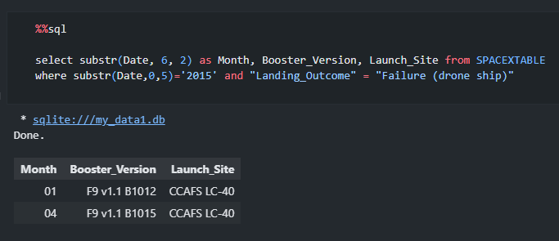
2015 Launch Records
Listing the failed landing outcomes in drone ship, their booster versions and launch site names for the months in year 2015.
Month | Booster_Version | Launch_Site
01 | F9 v1.1 B1012 | CCAFS LC-40
04 | F9 v1.1 B1015 | CCAFS LC-40

Slide 33
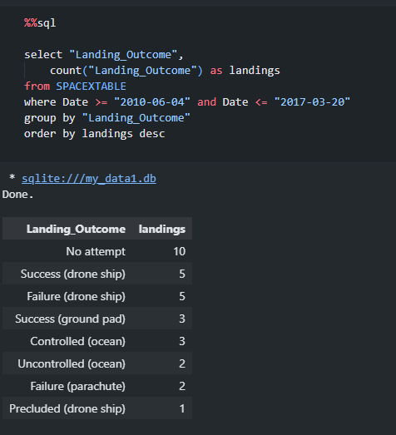
Rank Landing Outcomes Between 2010-06-04 and 2017-03-20
Ranking the count of landing outcomes (such as Failure (drone ship) or Success (ground pad)) between the date 2010-06-04 and 2017-03-20 in descending order

Slide 34
Interactive map with Folium
Section 3

Slide 35
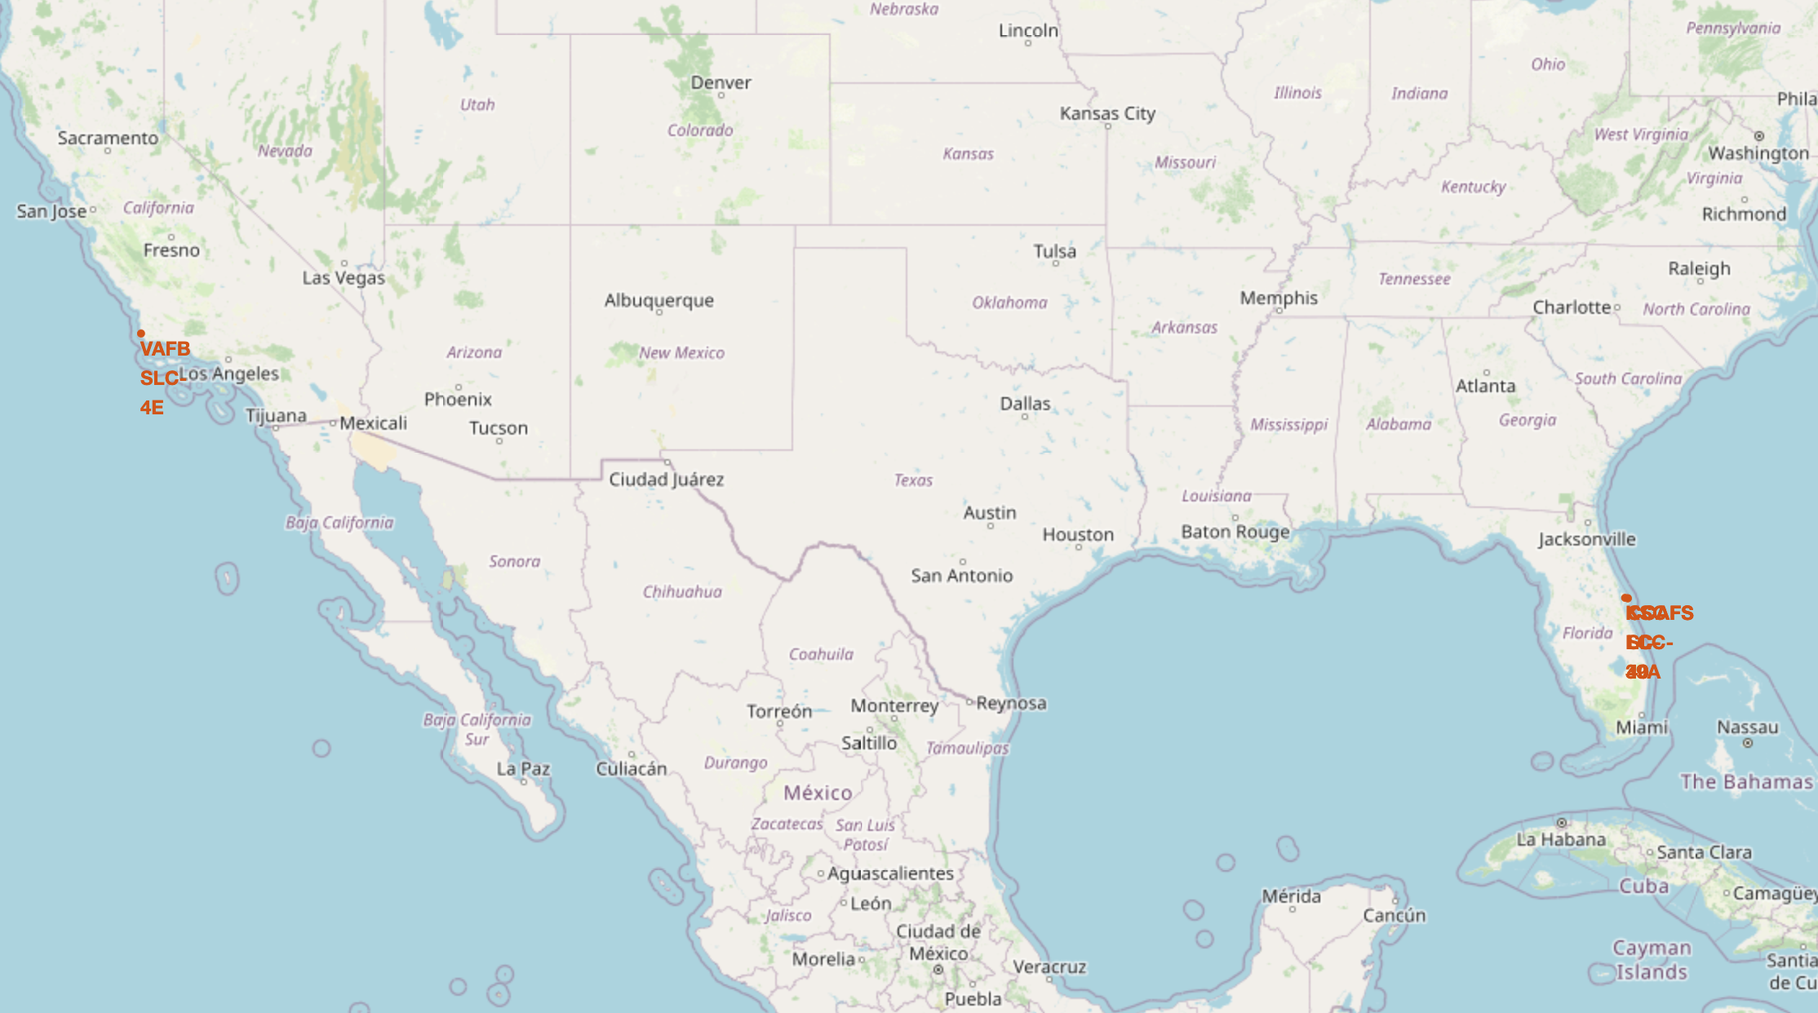
Locations of Launch Sites on Maps
Proximity to Equator: Launch sites are near the equator for higher initial velocity (1670 km/hour), aiding in achieving orbit.
Proximity to Coast: Launch sites are near the coast to minimize risk to people from debris.
Launch Site | Lat | Long
CCAFS LC-40 | 28.56230197 | -80.57735648
CCAFS SLC-40 | 28.56319718 | -80.57682003
KSC LC-39A | 28.57325457 | -80.64689529
VAFB SLC-4E | 34.63283416 | -120.6107455
All launch sites are in the south
Three are in the east
One is in the west
Notes:
Replace <Folium map screenshot 1> title with an appropriate title
Explore the generated folium map and make a proper screenshot to include all launch sites’ location markers on a global map
Explain the important elements and findings on the screenshot

Slide 36
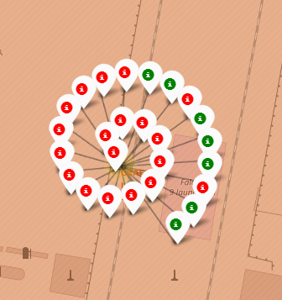
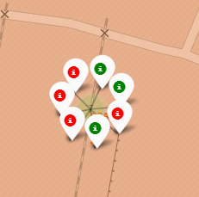
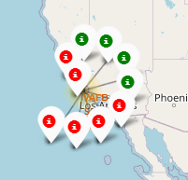
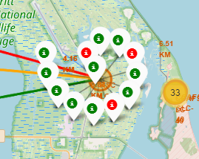
Launch Outcome Color Coded On the Map
Color-Labeled Markers: Easily identify success rates at launch sites.
Green Marker: Successful Launch
Red Marker: Failed Launch
Success Rates:
KSC LC-39A: High success rate
CCAFS LC-40 and CCAFS SLC-40: Lower success rates

Slide 37
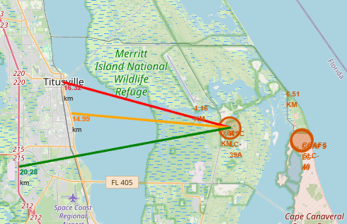
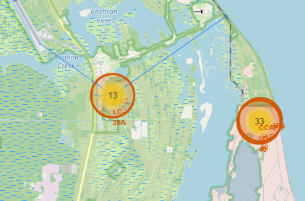
Distance from the Launch Site to Proximities
KSC LC-39A Proximity:
Near railway: 15.23 km
Near highway: 20.28 km
Near coastline: 14.99 km
Close to Titusville: 16.32 km
Nearest shuttle landing facility: 4.16 km
Coastline: ~6.5 km
Risk: Failed rockets can cover 15-20 km quickly, posing danger to populated areas.

Slide 38
Dashboard with Plotly Dash
Section 4

Slide 39
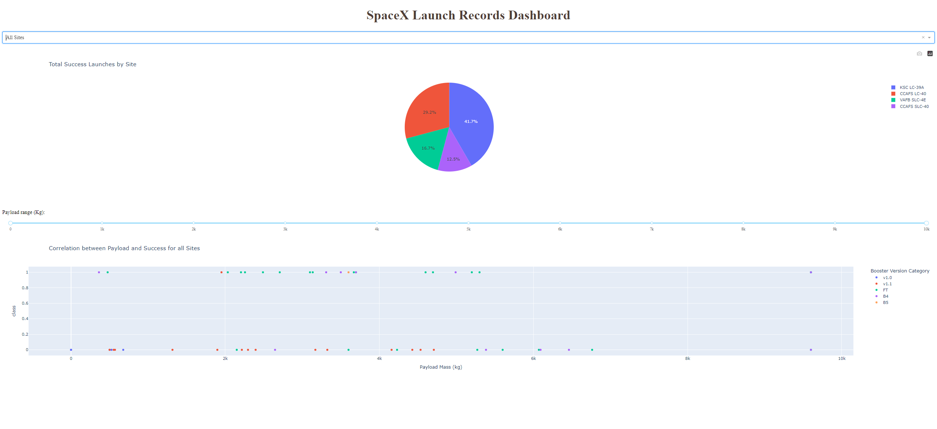
All sites launch success count
Pie Chart showing launch success count in percentage for all the sites
CCAFS LC-40: 29.2%
VAFB SLC-4E: 16.7%
KSC LC-39A: 41.7%
CCAFS SLC-40: 12.5%

Slide 40
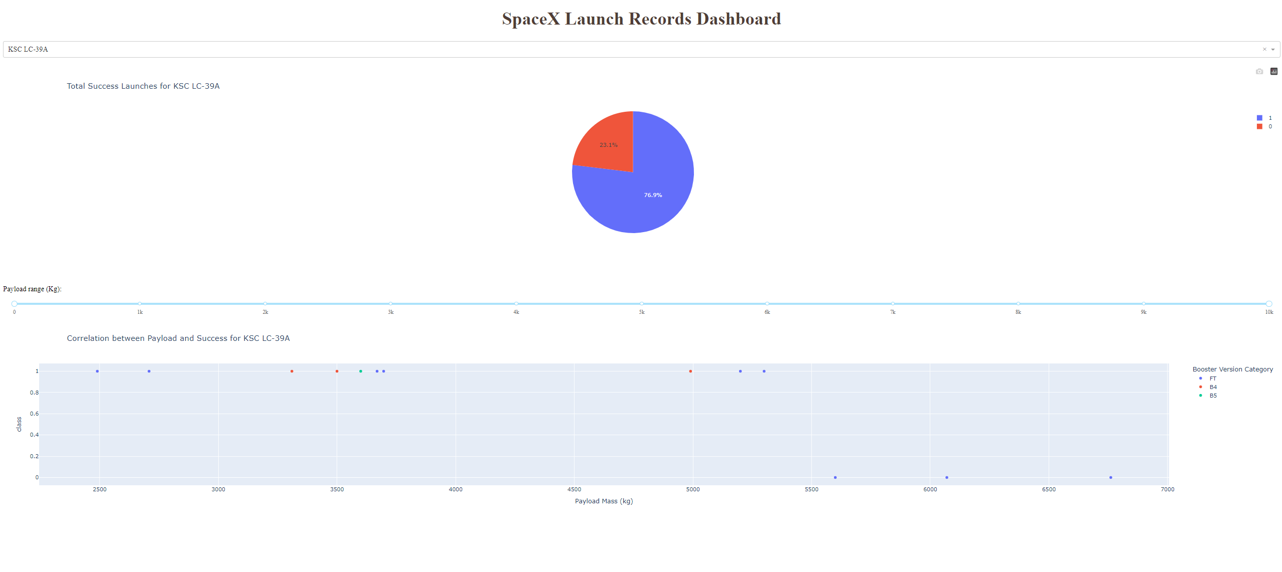
Highest launch success ratio
KSC LC-39A has the highest launch success rate: 76.9%
10 successful landing
3 failed landings

Slide 41
Payload Mass Vs Launch Outcome
Payload Success Rates:
Highest success rate for payloads between 2000 and 5500 kg.
Booster Version FT:
Largest success rate overall.
Successful launch with the largest payload (9.5k+ kg).

Slide 42
Predictive Analytics – Binary Classification
Section 5

Slide 43
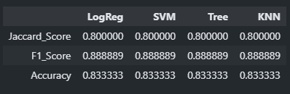
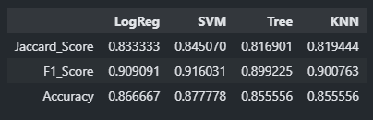
Classification Accuracy
The test set scores do not clearly indicate the best method due to the small sample size (18 samples). Therefore, we evaluated all methods using the entire dataset.
SVM performed the best overall with the highest Jaccard Score, F1 Score, and Accuracy.
Scores and Accuracy of the Test Set
Scores and Accuracy of the Entire Data Set

Slide 44

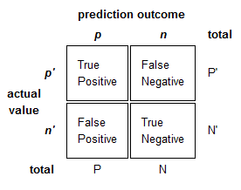
Confusion Matrix
SVM can distinguish between the two classes.
The key issue here being False Positives.
This Photo by Unknown Author is licensed under CC BY-SA

Slide 45
Discussion on predictive analytics
Handling the Issue:
Obtaining more data might be challenging due to rocket launches being rare and expensive.
Apply feature engineering techniques:
Regularization
Identify and remove unimportant columns through further EDA
Dimensionality reduction via PCA
Use other feature engineering methods like Polynomial Transformation
Dataset Limitations:
Only 90 rows with 83 columns.
80/20 split results in just 72 training records and 18 test samples.
More features than samples, leading to possible overfitting.

Slide 46
Conclusion – Key Takeaways
Best Algorithm: SVM is the best algorithm for this dataset.
Payload Mass: Launches with lower payload mass tend to be more successful than those with higher payload mass.
Launch Site Proximity: Most launch sites are near the equator and close to the coast, optimizing for initial velocity and minimizing risk to populated areas.
Success Rate Over Time: The success rate of launches has increased over the years.
Top Launch Site: KSC LC-39A has the highest success rate among all launch sites.
Orbit Success Rates: Orbits ES-L1, GEO, HEO, and SSO have a 100% success rate.

Slide 47
Appendix
Links:

Slide 48
THANK YOU

